Slide 1
LOG FILE ANALYZER
P. SAHANA:3BR22AI121
SUNIDHI.R.K:3BR22AI159
SUSHMA .K:3BR22AI161
TRUPTI .S:3BR22AI171

Slide 2
Overview:-
Introduction
Description
Demo Code
Pros and Cons
Conclusion

Slide 3
Introduction
Log file analysis:
Auditing server log files
Identifying bugs, crawling issues, and technical SEO problems
Log file analyzers:
Software tools
Parse and extract insights from log files
Provide information about system behavior, errors, events, performance, and anomalies

Slide 4
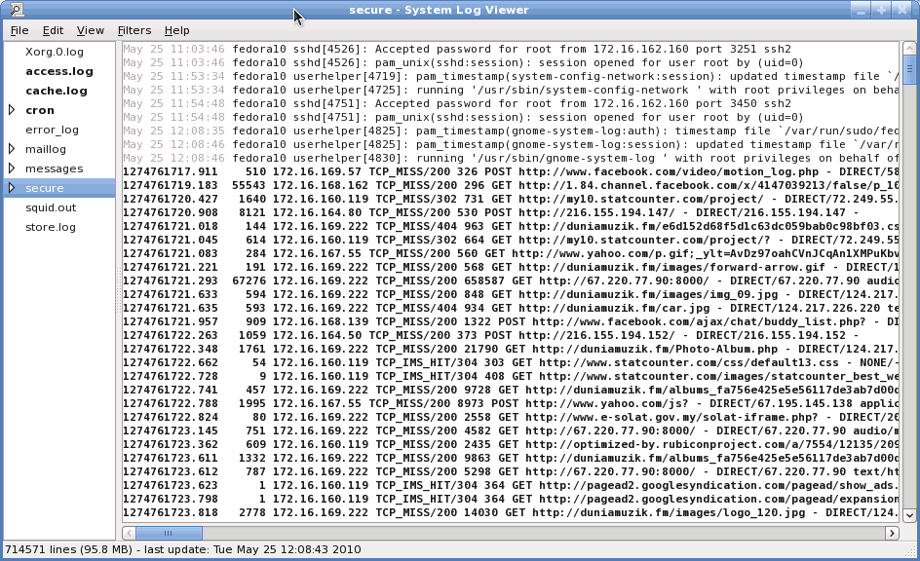
Example of Log File
1
2
3
Creating sample log file
Creating a log file of 100/any no of entries
Analysis of log file

Slide 5
Description Of Log File Analyzer
Purpose: Log file analysis is performed to extract useful information from log files generated by software or systems.
Types of Logs: Logs can contain various types of information such as errors, warnings, informational messages, debug messages, timestamps, and more.
Data Extraction: Log file analyzers extract relevant data from log files, such as error messages, warnings, timestamps, and log entry details.
Error and Warning Identification: Analyzers identify and categorize errors and warnings based on predefined criteria
Summary Generation: A summary of log file analysis includes the total number of errors, warnings, types of errors/warnings, trends, and anomalies.
Visualization: Data visualization techniques like charts, graphs, and tables can be used to represent log analysis results for better understanding.

Slide 6
Generating 100 Log Entries
Simulating Real-World Activity: To effectively analyze log files, you'll need a substantial amount of data to work with. By generating 100 log entries, you can create a realistic scenario that mirrors the types of events and activities your system experiences in daily operations.
Diverse Data Points :These 100 log entries should cover a range of events, from user actions and system processes to error messages and warning signs. This variety will help you identify patterns, trends, and potential issues more effectively.
Baseline for Analysis :The generated log entries will serve as a baseline, allowing you to compare and contrast future log data to identify changes, anomalies, and areas that require further investigation.

Slide 7
Analysis Log Files:-Log file analysis is the process of downloading and auditing your site’s log file to proactively identify bugs, crawling issues, and other technical SEO problems.
JHH open(): to open a file
print():print output to the console
analyze log file: searching for lines whichcontains co which contains either ERROR or WARNING.
it returns two lists one containing the lines
with errors , and other containing the lines
with warnings.
MODULES
FUNCTIONS

Slide 8
Function Definition (analyze_log_files):
This function analyze_log_file path as input.
It initializes two empty lists errors and warnings to store lines containing errors and warnings respectively.
2.Assigning log file name: It is assigned to system_logs.txt
3.Function Call: It is called with the log_file variable as argument.
4.Printing results:
*. The code prints a header Errors found.
*. After printing errors , it prints a separator.
*. It then prints ader warnings found.

Slide 9
DEMO CODE:

Slide 10
Pros of Log Files
Performance Monitoring
User Behaviour Analysis
Performance Optimization
Root Cause Analysis
Compliance and Auditing
Security
Monitoring
Issue Detection and Trouble
shooting:

Slide 11
Cons of Log File Analyzer
Complexity and Volume
Real-Time Analysis Challenges
Privacy and Compliance Concerns

Slide 12
Conclusion
Log file analysis is an essential task in many fields, such as system administration, security, and data science. By analyzing log files, you can gain valuable insights into system performance, user behavior, and potential issues.
Using Python for log file analysis is an excellent choice due to its extensive libraries and tools, such as:-
Re (regular expressions) for pattern matching
Pandas for data manipulation and analysis
Matplotlib and Seaborn for data visualization

Slide 13
DO YOU HAVE ANY QUESTIONS ?

Slide 14


